Slide 1


React JS
(localstorage)
Lecture-30

Slide 2
Today’s Agenda
Introduction
What Is localStorage ?
Methods Of localStorage
Examples
Exercise

Slide 3
Introduction
In the early days of the web, data persistence was only possible with a server.
Nowadays, through the use of localStorage, we can store data on clients like browsers and mobile apps without communicating with a back-end application.

Slide 4
What Is LocalStorage ?
localStorage is a property that allows JavaScript based sites and apps to store data locally within the user's browser with no expiration date.
The data will not be deleted even when the browser is closed, and will be available when the browser is opened again.

Slide 5
Good Points About LocalStorage
It stores up to 5-10MB of data (depending on the browser).
Easy to use – no need for a web server or backend database.
Great for getting an idea up and running and for testing purposes.

Slide 6
Bad Points About LocalStorage
It can only store strings.
It’s local to the browser
It’s not secure so we should not store any private or personal information in localStorage.

Slide 7
Where localStorage Lives ?
In Google Chrome, the local storage data is saved in an SQLite file in a subfolder located at \AppData\Local\Google\Chrome\User Data\Default\Local Storage
Firefox saves storage objects in an SQLite file called webappsstore.sqlite, which is also located in the user’s profile folder.

Slide 8
Methods Of localStorage
To use localStorage in our web applications, there are five methods :
setItem(): Add key and value to localStorage
getItem(): To get an item from localStorage
removeItem(): Remove an item by key from localStorage
clear(): Clear all localStorage
key(): Passed a number to retrieve the key of localStorage

Slide 9
Using The Method setItem()
Just as the name implies, this method allows us to store values in the localStorage object.
It takes two parameters: a key and a value.
Example:
window.localStorage.setItem('name', 'Sachin');

Slide 10
Using The Method setItem()
To store arrays or objects, we would have to convert them to strings.
To do this, we use the JSON.stringify() method before passing to setItem().
Example:
const person = {
name: "Sachin",
city: "Bhopal",
}
window.localStorage.setItem('user', JSON.stringify(person));

Slide 11
Using The Method getItem()
To get items from localStorage, we use the getItem() method.
It accepts only one parameter, which is the key, and returns the value as a string
Example:
let username=window.localStorage.getItem('name');

Slide 12
Using The Method getItem()
If we are reading an object from getItem() , then we will have to convert the returned string to object
To do this, we make use of the JSON.parse() method, which converts a JSON string into a JavaScript object.
Example:
let userdetails=window.localStorage.getItem(‘user’);
let person=JSON.parse(userdetails);

Slide 13
Using The Method removeItem()
To delete a key-value pair from localStroage we use the removeItem() method.
It accepts only one parameter, which is the key, and removes that key-value pair from localStorage
Example:
window.localStorage.removeItem('name');

Slide 14
Using The Method clear()
We use the clear() method to delete all items in localStorage.
This method, when invoked, clears the entire storage of all records for that domain.
Example:
window.localStorage.clear();

Slide 15
Using The Method key()
The key() method is used in situations where we need to loop through all the keys .
It allows us to pass a number or index to localStorage to retrieve the name of the key.
Example:
let keyName = window.localStorage.key(index);

Slide 16
Using The length Property
To get the number of key-value pairs, we can use the length property like this:
Example:
console.log(window.localStorage.length);

Slide 17
Exercise
Create an HTML Page which displays 2 textboxes for inputting name and age and two buttons for saving and loading
When the save button is clicked the data entered in the textboxes should be saved in localstorage
When the load button is clicked the data from localstorage should be read and displayed in the textboxes

Slide 18
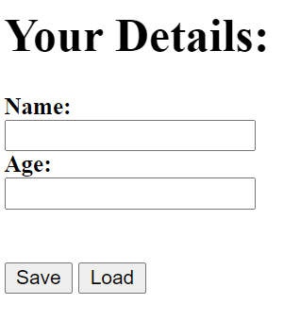
Desired Output

Slide 19
Solution
userdata.html
<!DOCTYPE html>
<html lang="en">
<head>
<title>Local Storage Demo</title>
<script>
function save() {
let txtName = document.querySelector("#name");
let txtAge = document.querySelector("#age");
let userName = txtName.value;
let userAge = txtAge.value;
localStorage.setItem("name", userName);
localStorage.setItem("age", userAge);
txtName.value = "";
txtAge.value = "";
} function load() {
let txtName = document.querySelector("#name");
let txtAge = document.querySelector("#age");
let userName = localStorage.getItem("name");
let userAge = localStorage.getItem("age");
txtName.value = userName;
txtAge.value = userAge;
}
</script></head>

Slide 20
Solution
userdata.html
<body>
<h1>Your Details:</h1>
<b>Name:</b><br />
<input type="text" id="name" /><br />
<b>Age:</b><br />
<input type="number" id="age" /><br />
<br /><br />
<button onclick="save()">Save</button>
<button onclick="load()">Load</button>
</body>
</html>

Slide 21
Exercise
Create an HTML Page which displays a counter whose value initially set to 0.
Provide 2 buttons , one for incrementing the counter and other for clearing it
When the increment button is clicked the counter should increment by 1 and when the clear button is clicked the counter should be reset to 0
And most importantly , when the browser is closed and opened again the counter should start from its last previous value

Slide 22
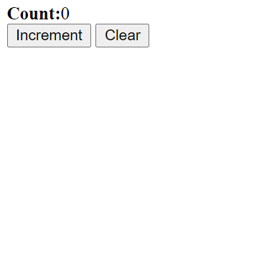
Desired Output

Slide 23
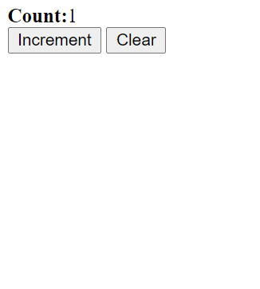
Desired Output

Slide 24
Solution
Counter.html
<!DOCTYPE html>
<html lang="en">
<head>
<title>Local Storage Demo</title>
<script>
function increment() {
let count = localStorage.getItem("counter");
count = Number(count) + 1;
localStorage.setItem("counter", String(count));
let span = document.querySelector("span");
span.innerHTML = "<b>Count:</b>" + count;
}
function reset() {
localStorage.clear();
let span = document.querySelector("span");
span.innerHTML = "<b>Count:</b>0";
}

Slide 25
Solution
Counter.html
function setUp() {
let count = localStorage.getItem("counter");
console.log("counter", count);
if (count === null) {
localStorage.setItem("counter", "0");
console.log("counter set!");
count = 0;
}
let span = document.querySelector("span");
span.innerHTML = "<b>Count:</b>" + count;
}
window.onload = setUp;
</script>
</head>
<body>
<span></span><br />
<button onclick="increment()">Increment</button>
<button onclick="reset()">Clear</button>
</body>
</html>

Slide 26
Exercise
Update the todoapp so that even after refreshing or reopening the browser , the tasks list should not get erased

